Slide 1
Compound Interest

Slide 2
Annual Compounding
Interest rate
Future Value
Initial Value or Principal
Time (years)
You invest $1,000 earning 6% annual interest. How much will you have after 5 years?

Slide 3
The first example was one in which the principal was compounded one time each year. Banks also offer interest compounded multiple times per year, or n times per year.

Slide 4
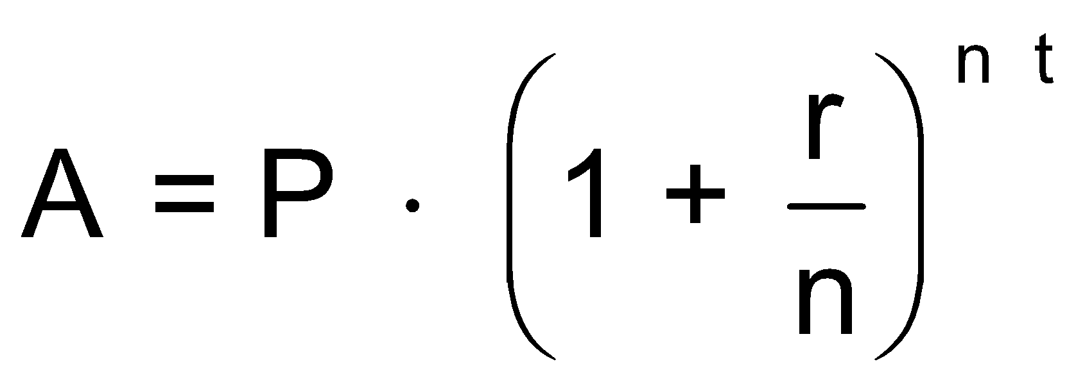
Compounding n times per year
Interest rate
Future Value
Initial Value or Principal
Time (years)
# of times compounded per year
You invest $1,000 earning 6% interest compounded quarterly. How much will you have after 5 years?

Slide 5
Yearly
Quarterly
Monthly
Weekly
Daily

Slide 6
Continuous Compounding
Interest rate
Time (years)
Future Value
Initial Value or Principal
A constant ≈ 2.71828
You invest $1,000 earning 6% interest compounded continuously. How much will you have after 5 years?

Slide 7
Yearly
Quarterly
Monthly
Weekly
Daily
Continuously

Slide 8
Compound Interest

