Slide 1
Finding the Golden Ratio
Copyright © 2003, N. Ahbel

Slide 2
short
long
whole
short
long
=
long
whole

Slide 3
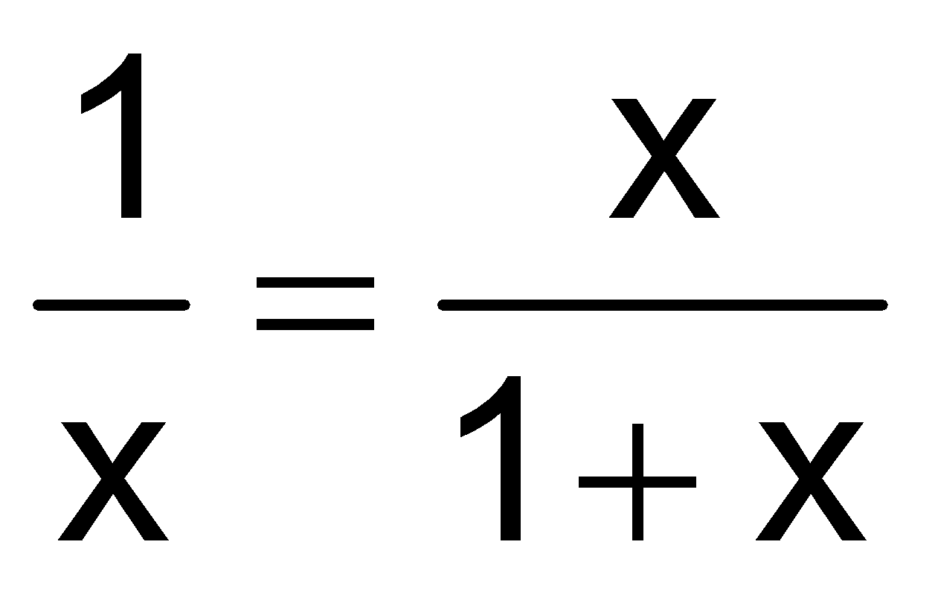
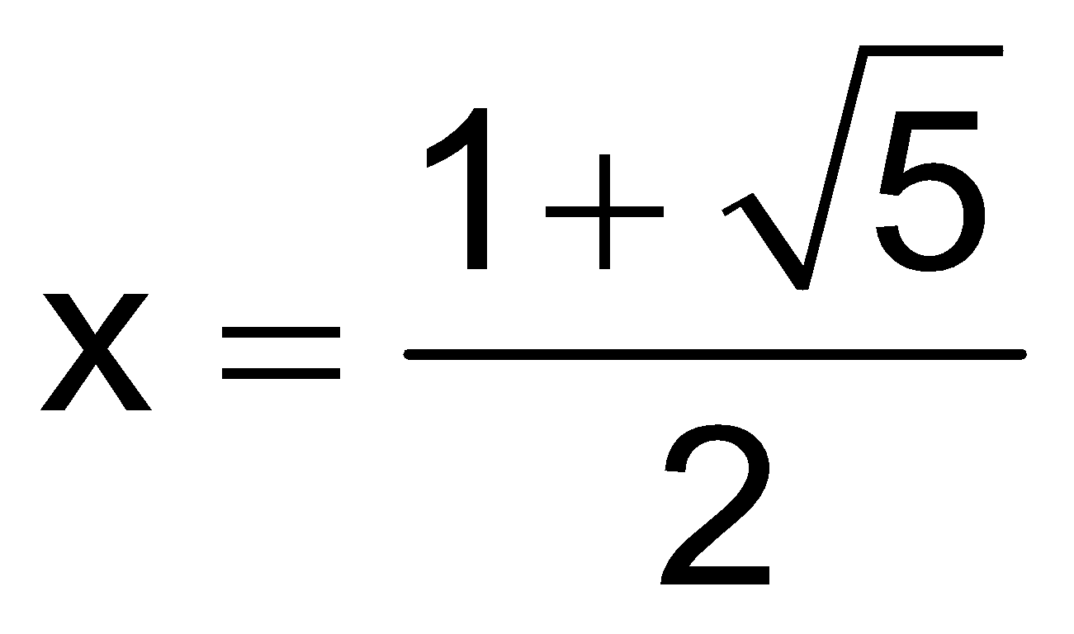
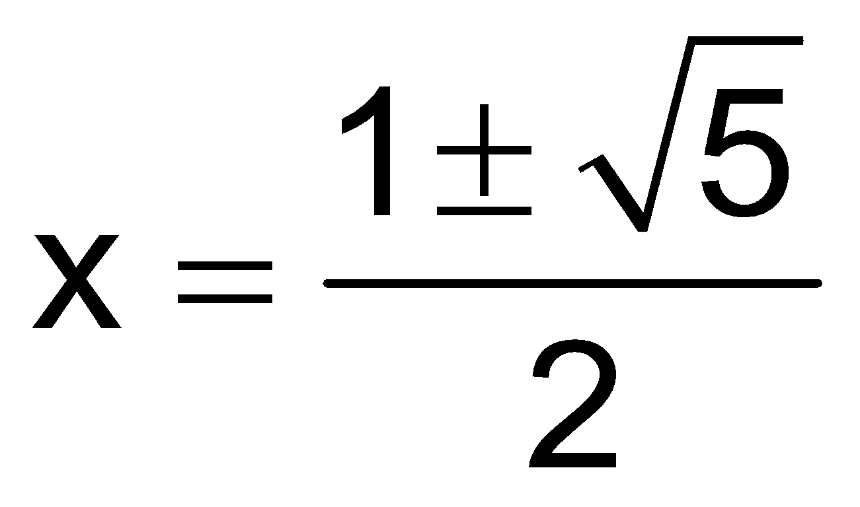
short
long
whole
short
long
Let short = 1 and long = x
=
long
whole
We are looking for a length so…

Slide 4
Golden Ratio
Golden Rectangle

Slide 5
Finding the Golden Ratio
Copyright © 2003, N. Ahbel

