Slide 1
Spin the Data Project: Hydraulic Fracturing
My post (for)
Grading Rubric
3
4
3
4
5
5
My reply (for) to someone’s post
(against)
3
Poor sources,
poor citations,
not data-based
doesn’t reply to post
Good, nothing wrong
Adheres to all guidelines
Very, very well done
4
5
Total = ???

Slide 2
Chapter 1 Project: Hydraulic Fracturing
Guidelines
1. You are to do this assignment by yourself, without getting help from anyone else.
2. Base your writing on scientific, statistical evidence, not just notions or opinions.
3. Give a complete citation (with URL) for your source and attribute (connecting ideas that are not yours to the citations)
4. Be convincing. After reading your post or reply, the reader should be convinced that you are right.

Slide 3
Chapter 1 Project: Hydraulic Fracturing
Guidelines
5. Be succinct and concise. Each post and reply should be about one paragraph with one or two major points.
6. No graphics, just text. This assignment is about writing.
7. Do not write in first person. No attachments; everything in the body of the post/reply.
2. Base your writing on scientific, statistical evidence, not just notions or opinions.
8. When writing your reply, go to your “opponent’s” source and see if you can spin the same data in your direction.

Slide 4
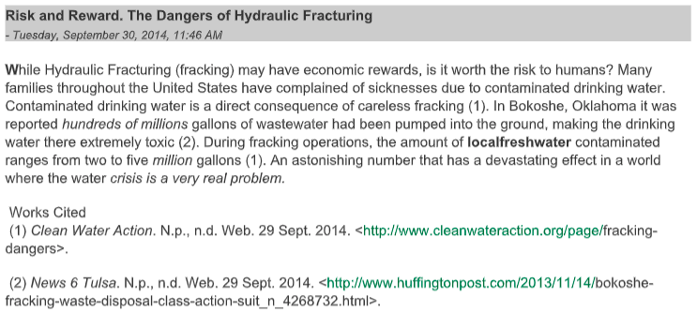
Sample Posts
3

Slide 5
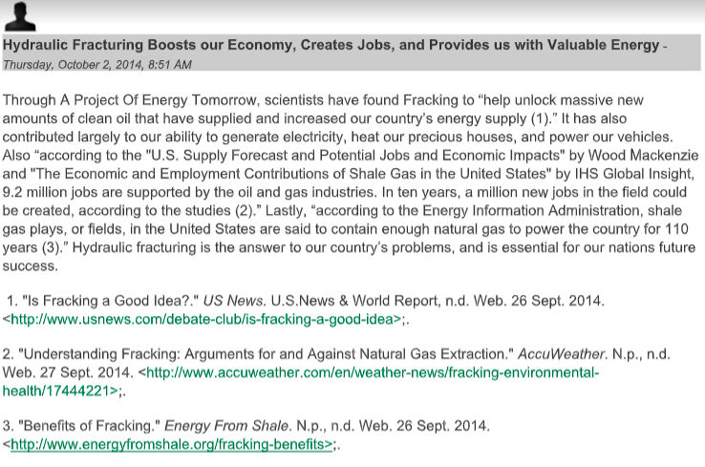
4

Slide 6
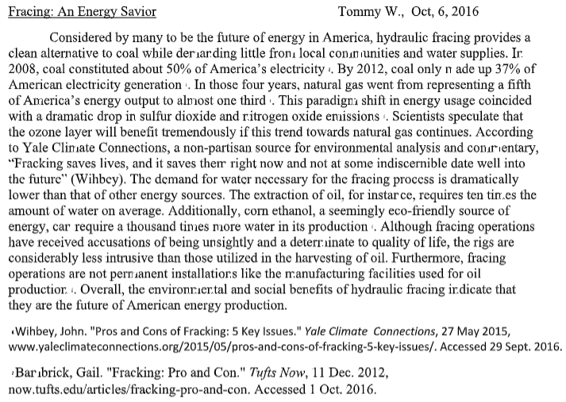
Sample Posts
4.5

Slide 7
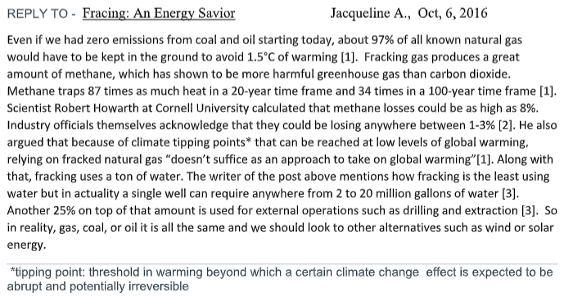
4.5

Slide 8
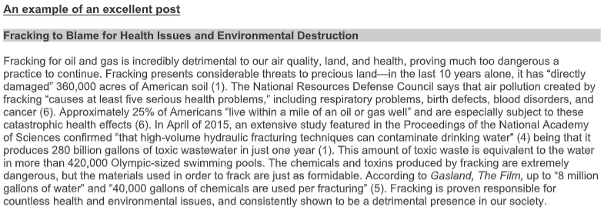
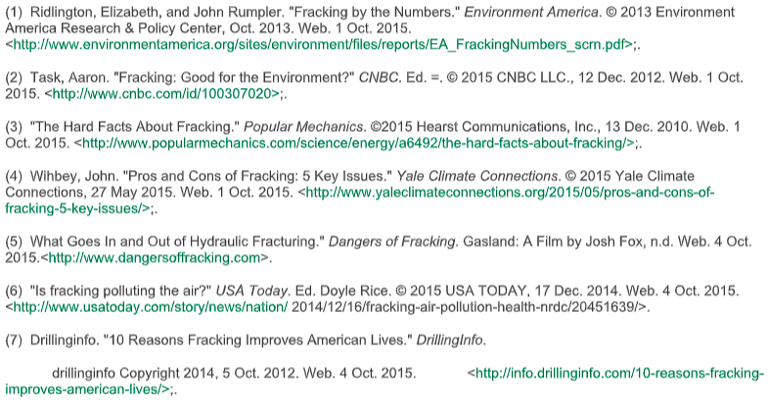
5

Slide 9
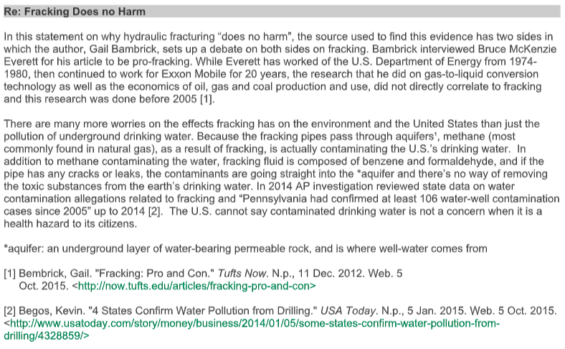
5

